Slide 1


Crime Category Prediction
Prepared By :
Harshil Munjpara (20230804004)
Prit Mahant (20230804059)
Prajakta Bote (20230804067) CLASS OF:
MASTER IN COMPUTER APPLICATION

Slide 2
INTRODUCTION
It imposes the uses of existing crime data and predicts the crime type and its occurrence bases on the location and time.
In an era dominated by an unprecedented volume of data, the intersection of technology and law enforcement has become increasingly vital. The Crime Category Prediction Project is an innovative initiative aimed at harnessing the power of data science and machine learning to enhance the efficiency of crime analysis and prediction.

Slide 3
Some Of the hotspots analyzed has made classifying the crime patterns easier.
This proposal suggests employing machine learning algorithms to identify matching criminal patterns, categorizing them based on provided temporal and spatial data.

Slide 4
PROPOSED SYSTEM
The proposed system is made on the basis of the research work that is done by going through various such
documentations.
Nearly all of the crimes are predicting based on the location and the types of crimes that are occurring in those areas.
On surveying previous works, Linear Regression, Decision Tree and Random Forest tend to give good accuracy so
these models are used in this paper to predict crimes.

Slide 5
FLOWCHART
DataSet
TrainingSet
Learning Algorithms
Final Model
PreProcessing
Sampling
TestingSet
Model Evaluation

Slide 6
Model_selection
ensemble
preprocessing
cluster
metrics
neighbors
Train_test_split
tree
Libraries
Confusion_matrix
labelEncoder
sklearn
kneighborsclssifer
numpy
randomforestclassifier
seaborn
kmeans
pandas
dicsiontreeclassifier
matplotlib
pyplot

Slide 7
ALGORITHM

Slide 8
Dataset
DATASET | ROWS | COLUMNS
Dataset | 878049 | 09
Training Dataset | 614634 | 06
Testing Dataset | 263415 | 06

Slide 9
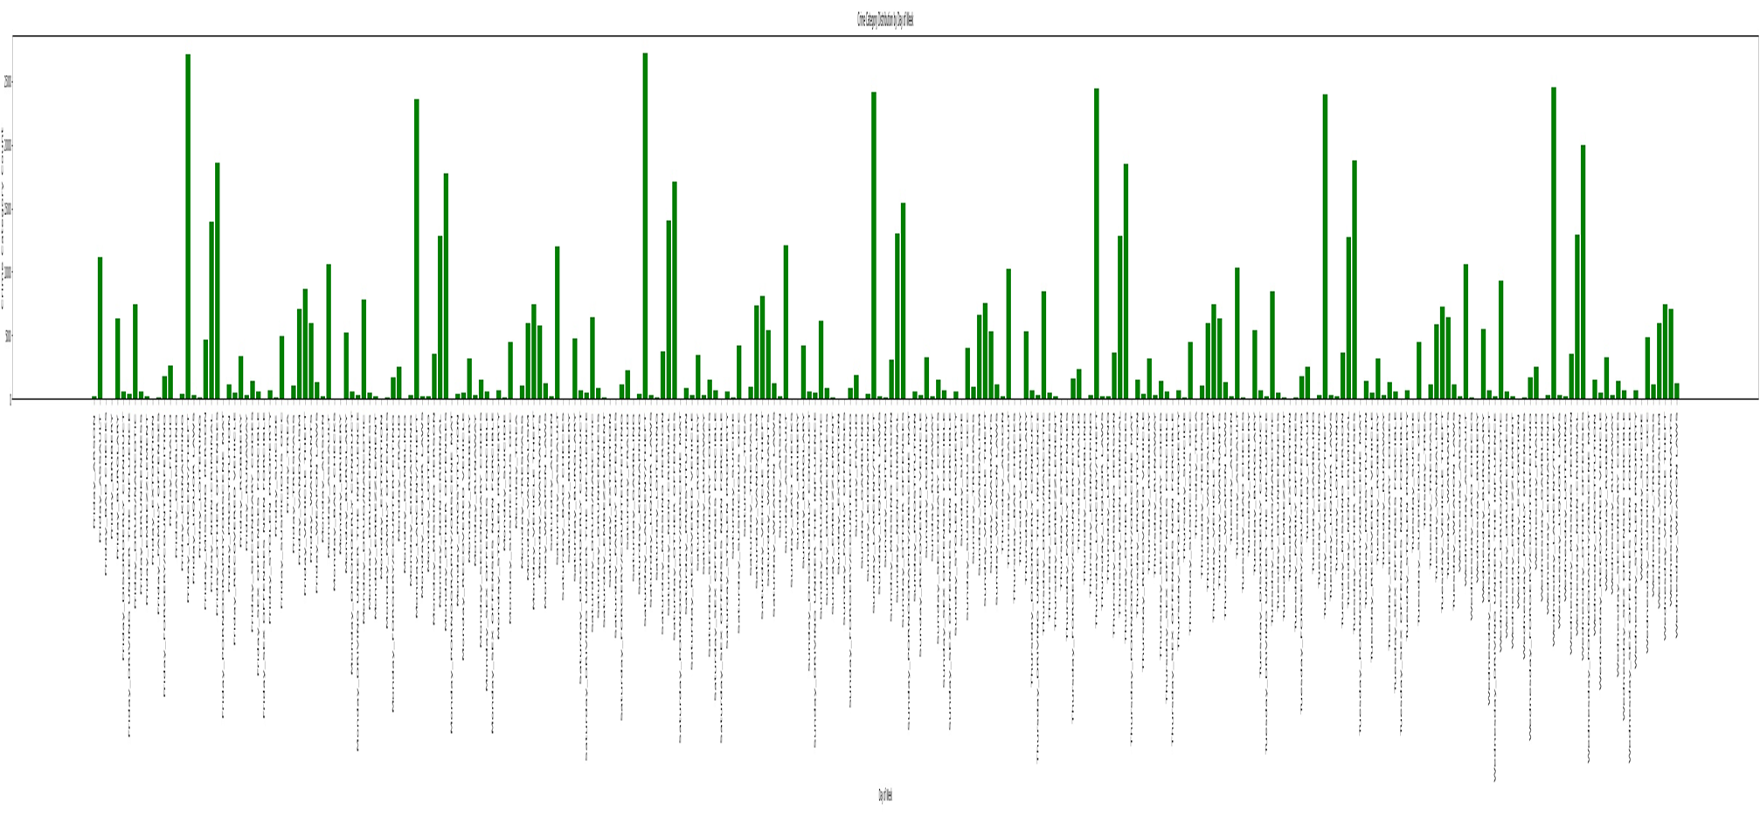
Data analysis

Slide 10
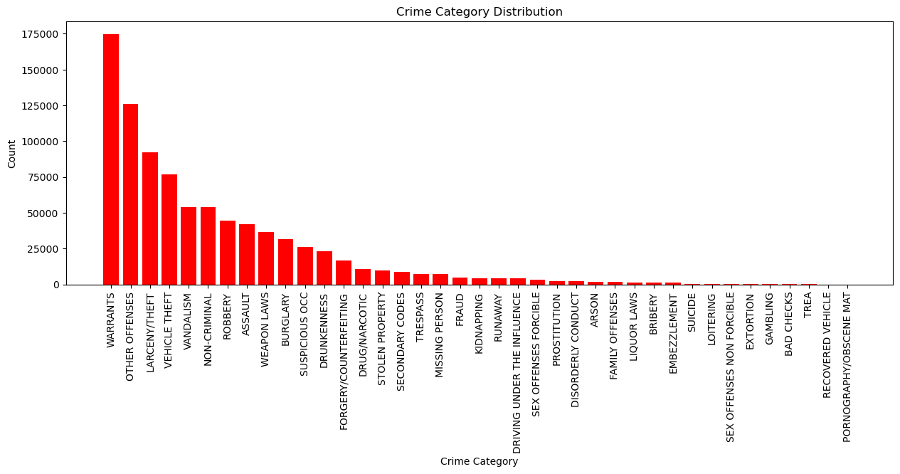

Slide 11


